Slide 1
OOPs concepts

Slide 2
Limitations of using older programming languages
Procedural Oriented Programming was the most widely used traditional language before OOPs was introduced.
The program written in procedural language is like a list of instructions.
Example: For adding two numbers:
Get two inputs
Add these two numbers
Display the output
Such step by step approach is called top-down approach.
If there are multiple functions in the program which are sharing some important data, such items are placed globally so that they can be accessed by all the functions
Since all the function has access to the global data, it can be modified by any function which can break down the entire program.

Slide 3
Why do we need OOPs?
OOPs was introduced to overcome the limitations in procedural approach programming.
Such as reusability & maintainability of code.
In OOP problem is divided into number of entities called objects and then build data and functions around these objects.
Data of an object can be accessed only by the function associated with that object.
OOPs follows bottom-up approach.
Provides greater security like data hiding.

Slide 4
OOPs vs Procedural Programming
 | Procedural Programming | OOPs
Security | Less secure than OOPs | Data hiding is possible in object-oriented programming due to abstraction. So, it is more secure than procedural programming.
Approach | It follows top-down approach | It follows bottom-up appraoch
Access modifiers | NA | The access modifiers in OOP are named as private, public, and protected.
Code reusability | No code reusability present | It offers code reusability by using inheritance.
Examples | Examples of Procedural programming include C, Fortran | Examples of OOP are .net, C#, java, etc.

Slide 5
Top-down Approach vs Bottom-up Approach
Top-down Approach | Bottom-up Approach
It is the process of breaking the overall tasks into different modules and then sub divide each module until the lowest level of detail has been reached. | Lower level problems are first solved and then are integrated to provide the solution of single large problem.
Contains redundant code. | Code redundancy can be eliminated
Structural/procedural oriented programming language follows the top-down approach | Object orientd programming language follows the bottom-up approach

Slide 6
OOPs Concetps
Object
Class
Abstraction
Encapsulation
Inheritance
Polymorphism

Slide 7
Objects
An entity that has state and behavior is known as an object.
An object has three characteristics:
State: represents the data (value) of an object.
Behavior: represents the behavior (functionality) of an object such as start, stop, etc.
Identity: An object identity is typically implemented via a unique ID. The value of the ID is not visible to the external user. However, it is used internally by the machine to identify each object uniquely.
Example: A car is an object which has model number, colour, mfg date as it's state and it can perform acceleration, break, etc which is it's behaviour.

Slide 8
Class
Collection of objects is called class.
A class can also be defined as a blueprint from which you can create an individual object.
Once a class has been defined,
we can create any number of objects for that class.

Slide 9
Abstraction
Abstraction refers to represtation of necessary information without including more details.
Example: When a friend or relatives come to our house, we show them the necessary things required for them like kitchen, washroom, guest room and such things.

Slide 10
Encapsulation
Encapsulation refers to a mechanism of restricting direct access to some data that doesn't have public access.
It is used to hide the secure data and provide greater security to it.
Example: Like in our previous example in abstraction, if the guest asked about the paint's brand or any minor information then we can make sure wether such information can pe given or not, here we can tell them the name of the brand or shop from where the paint is bought.
But if the friend ask about the loacker room where you keep your gold or important data, then we will never provide any information about it.
In simpler words, by encapsulation we provide abstraction as well as data hiding.
Using data hiding we provide greater security to private things.

Slide 11
Tightly Encapsulation
A special condition of encapsulation in programming, where if all the data members of the class is private then the class is said to be tightly encapsulated.
Example:
class A{
private int balance;
public int getBalance() { return balance(); }
}

Slide 12
Inheritance
The mechanism of deriving a derived or child from the base or parent class is called inheritance.
It is an important feature of OOPs because it provides re-usability of code.
Inheritance represents the IS-A relationship which is also known as a parent-child relationship.
It is just like saying that “A is type of B”. Example: “Apple is a fruit”, “Ferrari is a car”.
The extends keyword is used to make a new class derives from an existing class.
Example:
class SubClass extends ParentClass
{
//methods and fields
}

Slide 13
Types of Inheritance
There are different types of inheritance:
Single level inheritance
Multi-level inheritance
Multiple inheritance
Hierarchical inheritance
Hybrid inheritance

Slide 14
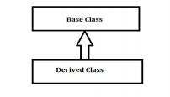
Single level inheritance
When a class inherits another class, it is known as a single inheritance.
Example: class A inherits the class B

Slide 15
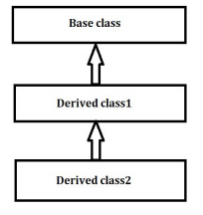
Multi-level inheritance
In Multi-Level Inheritance in Java, a class extends to another class that is already extended from another class.
For example, if there is a class A that extends class B and class B extends from another class C, then this scenario is known to follow Multi-level Inheritance.

Slide 16
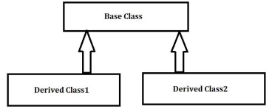
Hierarchical inheritance
In Hierarchical Inheritance, more than one derived class extends a single base class.
In simple words, more than one child class extends a single parent class, or a single parent class has more than one child class.

Slide 17
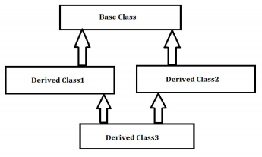
Hybrid inheritance
Hybrid Inheritance is a combination of different types of inheritances. In this type of Inheritance, more than one kind of inheritance is observed.
For example, if we have class A and class B that extend class C and then there is another class D that extends class A, then this type of Inheritance is known as Hybrid Inheritance.

Slide 18
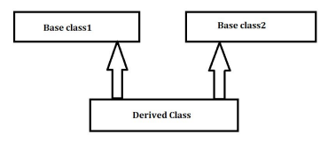
Multiple inheritance
Defining derived class from numerous base classes is known as ‘Multiple Inheritance’. In this case, there is more than one superclass, and there can be one or more subclasses.
Java does not support multiple inheritance.
Consider a case where class B extends class A and Class C and both class A and C have the same method display().
Now java compiler cannot decide, which display method it should inherit. To prevent such situation, multiple inheritances is not allowed in java.

Slide 19
The Diamond Problem
Java does not allow multiple inheritance, where one class can inherit properties from more than one class. It is known as the diamond problem.
It is an ambiguity that can rise because of allowing multiple inheritance.
The solution to the diamond problem is interfaces. We can achieve multiple inheritance by using these interfaces.

Slide 20
Polymorphism
Polymorphism is derived from 2 Greek words: poly and morphs.
The word "poly" means many and "morphs" means forms. So, polymorphism means many forms.
For exampl: '+' is used to make sum of two numbers as well as it is used to combine two strings.
This is known as operator overloading because same operator perform differently on different instances.
Same way function can also be overloaded.
Example: area() function can take two or three arguments i.e., area(5) or area(4,2).
Single function area() gives area of different shapes as per the arguments provided to it.

Slide 21
Types of polymorphism
There are two types of polymorphism in Java: compile-time polymorphism and runtime polymorphism.
We can perform polymorphism in java by method overloading (compile-time) and method overriding (runtime).

Slide 22
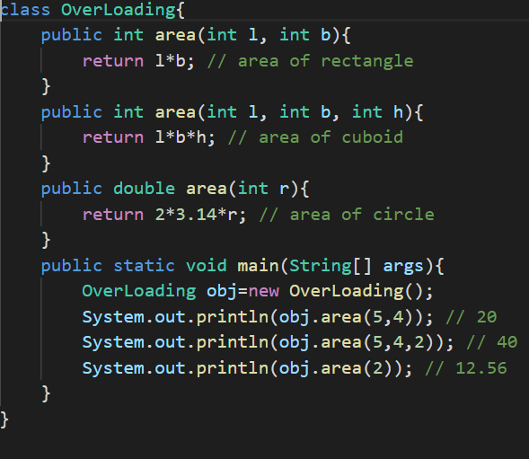
Overloading Program:

Slide 23
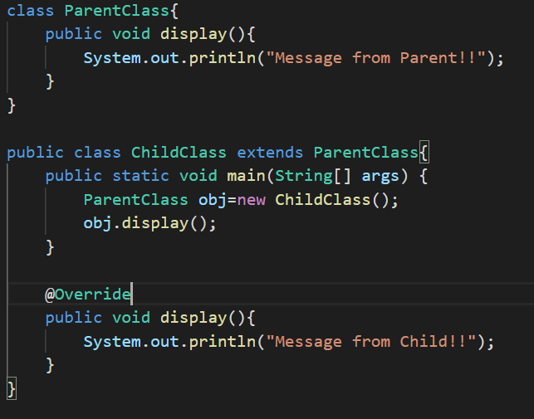
Overriding:

Slide 24
Access Modifiers
The access modifiers in Java specifies the accessibility or scope of a field, method, constructor, or class.
We can change the access level of fields, constructors, methods, and class by applying the access modifier on it.
There are four types of Java access modifiers:
Private
Protected
Public
Default

Slide 25
Access Modifiers
Private: The access level of a private modifier is only within the class. It cannot be accessed from outside the class.
Default: The access level of a default modifier is only within the package. It cannot be accessed from outside the package. If you do not specify any access level, it will be the default.
Protected: The access level of a protected modifier is within the package and outside the package through child class. If you do not make the child class, it cannot be accessed from outside the package.
Public: The access level of a public modifier is everywhere. It can be accessed from within the class, outside the class, within the package and outside the package.

Slide 26
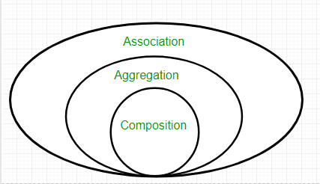
Association, Composition and Aggregation
Association is a relation between two separate classes which establishes through their Objects.
It can be one-to-one, one-to-many, many-to-one, many-to-many.
In OOP, an Object communicates to another object to use functionality and services provided by that object.
Composition and Aggregation are the two forms of association.

Slide 27
Aggregation
Aggregation is a special form of Association.
It is a unidirectional association i.e., a one-way relationship.
Example: A bike can have a motor, but reverse is not possible and thus unidirectional in nature.
In Aggregation, both the entities can survive individually which means ending one entity will not affect the other entity.
It is additionally utilized for code reusability.
Let us take an example of Student and Address class. Each student must have an address so relationship between Student class and Address class will be Has-A type relationship but vice versa is not true(it is not necessary that each address contain by any student). So, Student work as owner entity. This will be an aggregation relationship.

Slide 28
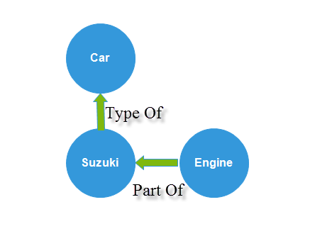
Composition
Composition is a restricted form of Aggregation in which two entities are highly dependent on each other.
It represents part-of relationship.
When there is a composition between two entities, the composed object cannot exist without the other entity i.e., both entities are interdependent of each other.
Example:
Engine is part of car
Heart is part of body

Slide 29
static keyword
The static keyword is used for memory management mainly.
We can apply static keyword with variables, methods, blocks and nested classes.
The static keyword belongs to the class than an instance of the class.
If we need to define some method or state that will be common to all objects, we define it as static.

Slide 30
Static variable
If you declare any variable as static, it is known as a static variable.
The static variable can be used to refer to the common property of all objects, for example, the company name of employees, college name of students, etc.
The static variable gets memory only once in the class area at the time of class loading.

Slide 31
Static method
If you apply static keyword with any method, it is known as static method.
A static method belongs to the class rather than the object of a class.
A static method can be invoked without the need for creating an instance of a class.
A static method can access static data member and can change the value of it.
Restrictions for the static method:
The static method can not use non static data member or call non-static method directly.
this and super cannot be used in static context.

Slide 32
Static block
It is used to initialize the static data member.
It is executed before the main method at the time of class loading.

Slide 33
Why can’t outer class be static?
Every class is already common to all of its objects, and there is no need to make it static to become available to all of its objects.
We need a class name to access its static members because these members are part of a class while an outer class is part of a package. We can directly access the class by just writing package_name.class_name (similar to class_name.static_field_name). So again, there is no need to do something that's already there by default.
We do not need any object to access a class if it is visible. We can simply write package_name.class_name to access it. And by definition, a class is a blueprint for its objects, and we create a class to create objects from it (though an exception will always be there, like java.lang.Math). Again, there is no need to define an outer class as static.

Slide 34
Constructors
A constructor is a block of codes similar to the method.
It has the same name as that of the class name.
It does not have any return type.
It is called when an instance of the class is created. At the time of calling constructor, memory for the object is allocated in the memory.
It can not be overridden by the subclass.
Every time an object is created using the new() keyword, the constructor is called.
It can have access specifiers.
It cannot be have abstract, static or final keywords.

Slide 35
Types of constructor
Default constructor: if there is no constructor available in the class, Java compiler provides a default constructor by default. It doesn't have any parameter.
Parameterized constructor: A constructor which has a specific number of parameters is called a parameterized constructor.

Slide 36
Why abstract, final, static not allowed in constructor?
A constructor is not allowed to be abstract, final or, static. So, there is no static constructor in Java.
The constructors in Java can not be static because if the constructors are marked as static, they can not be called from the child class; thus, the child class's object will not be created. The program will not be compiled and throw a compile-time error.

Slide 37
Private constructor
A private constructor in Java is used in restricting object creation.
It is a special instance constructor used in static member-only classes.
If a constructor is declared as private, then its objects are only accessible from within the declared class. You cannot access its objects from outside the constructor class.
Use case: Singleton class.

Slide 38
Singleton Class
A singleton class is a class that can have only one object at a time.
While creating a singleton class:
the constructor should be private,
a static method that has return type object of this singleton class.

Slide 39
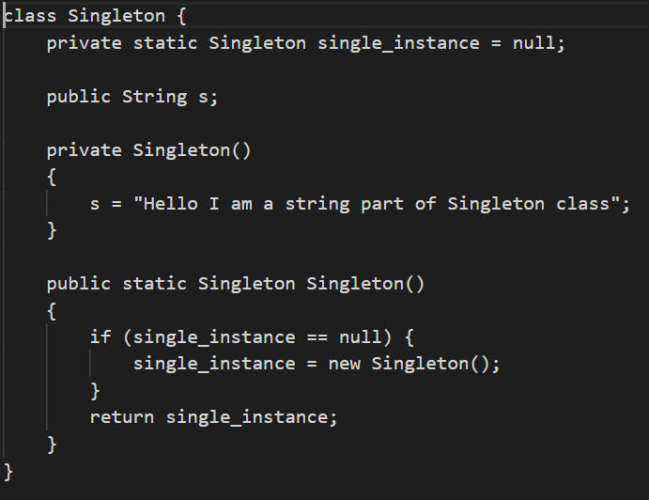
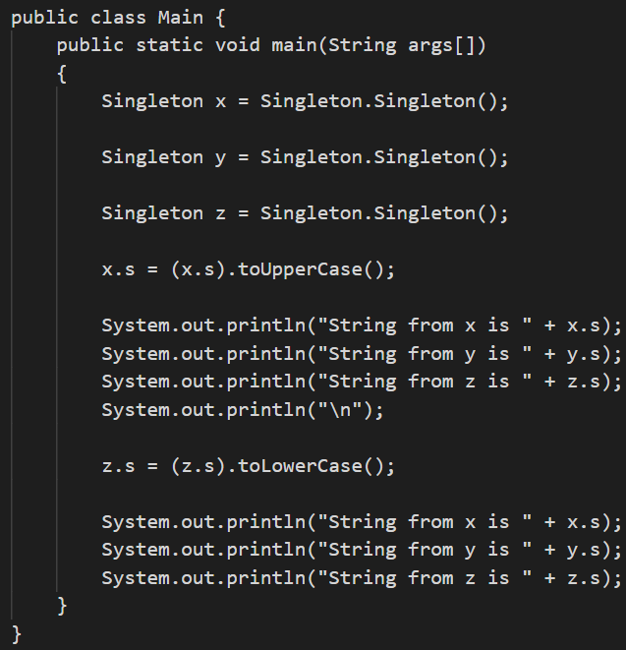
Singleton Class Program:

Slide 40
Destructor (Garbage Collector)
When we create an object of the class it occupies some space in the heap memory.
If we do not delete these objects, it remains in the memory and occupies unnecessary space that is not upright from the aspect of programming.
To resolve this problem, we use the destructor.
The destructor is the opposite of the constructor. The constructor is used to initialize objects while the destructor is used to delete or destroy the object that releases the resource occupied by the object.
There is no concept of destructor in Java. In place of the destructor, Java provides the garbage collector that works the same as the destructor.

Slide 41
Destructor (Garbage Collector)
It is a special method that automatically gets called when an object is no longer used.
When an object completes its life-cycle the garbage collector deletes that object and deallocates or releases the memory occupied by the object.
In Java, the allocation and deallocation of objects handled by the garbage collector.
It is automatically invoked at the end of the program execution.

Slide 42
Abstraction
A class which is declared as abstract is known as an abstract class.
It can have abstract and non-abstract methods.
It needs to be extended and its method implemented. It cannot be instantiated.
An abstract keyword is used to declare a class as an abstract class.

Slide 43
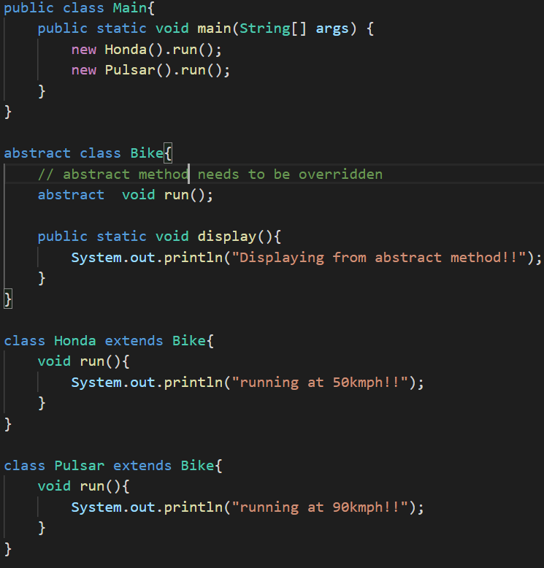
Example of Abstract class:

Slide 44
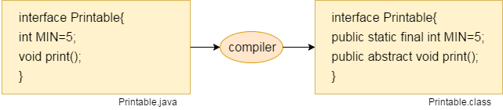
Interface
There can be only abstract methods in the interface, not method body.
It is used to achieve abstraction and multiple inheritance in Java.
It can be used to achieve loose coupling.
The Java compiler adds public and abstract keywords before the interface method. Moreover, it adds public, static and final keywords before data members.

Slide 45
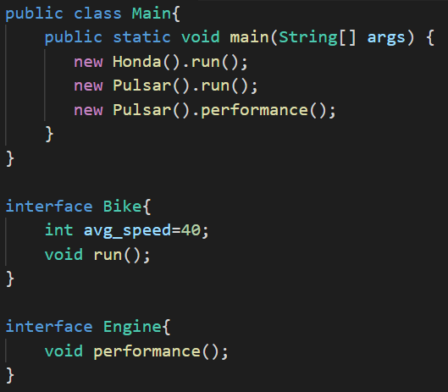
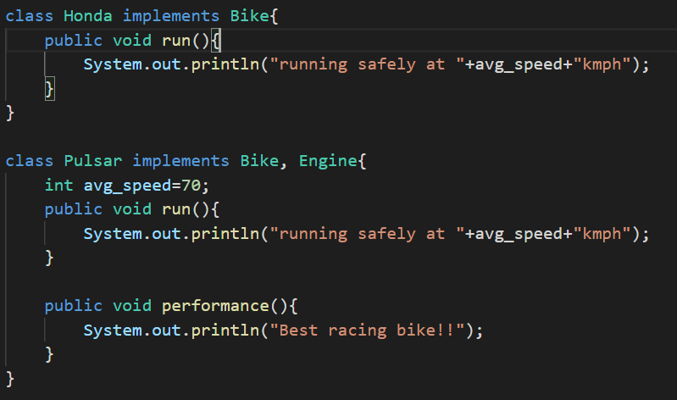
Example of interface:

Slide 46
Stack Memory
Stack space is mainly used for storing order of method execution and local variables.
Stack always stored blocks in LIFO order.
Stack memory is used to store items which have a very short life like local variables, a reference variable of objects
Primitives data types like int, float, double and, other data types are stored in stack memory.

Slide 47
Heap Memory
Heap memory used for dynamically allocating and deallocating memory blocks.
Memory allocated to the heap lives until one of the following events occurs:
Program terminated
Memory free
Heap memory is allocated to store objects.
Garbage collector always free the heap memory after it is used.
Non-Primitives data types Array, String and Object are stored in heap memory.

Slide 48
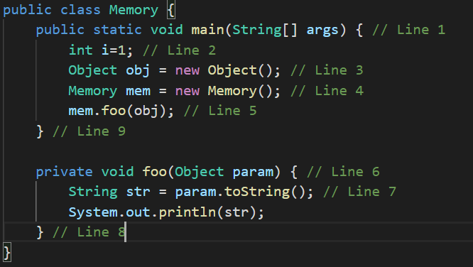
Program:

Slide 49
